Slide 1
Lab2

Slide 2
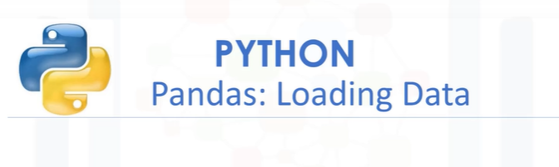

Slide 3
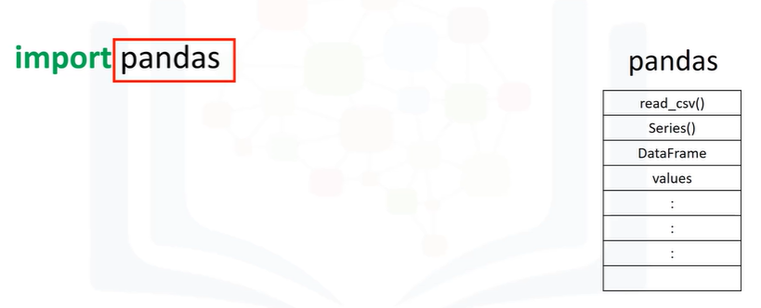
we will introduce pandas–a popular library for data analysis.
We can import the library or a dependency like pandas using the following command.
We start with the import command followed by the name of the library.

Slide 4
We now have access to a large number of pre-built classes and functions.
This assumes the library is installed.
In our lab environment, all the necessary libraries are installed.
Let’s say we would like to load a csv file using the pandas built-in function “read csv.”
A csv is a typical file type used to store data.
We simply type the word pandas, then a dot and the name of the function with all the inputs

Slide 5
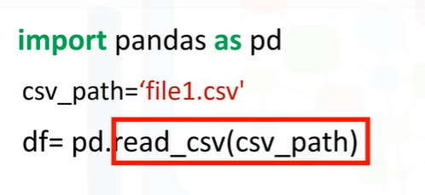
Typing pandas all the time may get tedious.
We can use the "as" statement to shorten the name of the library; in this case we use the standard abbreviation pd. Now we type pd and a dot followed by the name of the function we would like to use, in this case, read_csv.

Slide 6
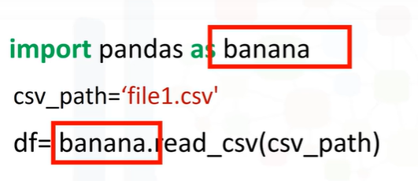
We are not limited to the abbreviation pd. In this case, we use the term, banana.
We will stick with pd for the rest of this video.
Let’s examine this code more in-depth.
One way pandas allows you to work with data is with a data frame.

Slide 7
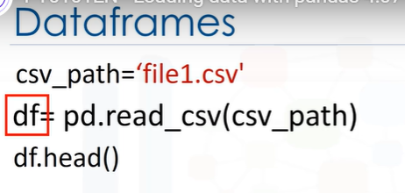
Let's go over the process to go from a csv file to a data frame.
This variable stores the path of the csv.
It is used as an argument to the read_csv function.
The result is stored to the variable df; this is short for “dataframe."

Slide 8
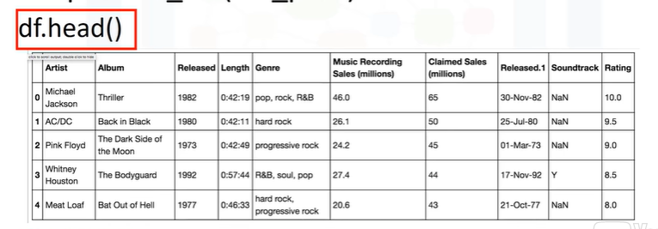
Now that we have the data in a dataframe, we can work with it.
We can use the method head to examine the first 5 rows of a dataframe.

Slide 9
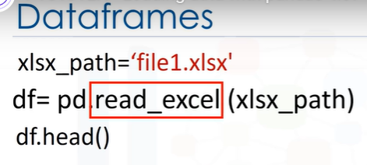
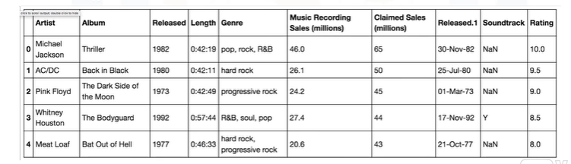
The process for loading an excel file is similar. We use the path of the excel file.
The function reads excel. The result is a dataframe.

Slide 10
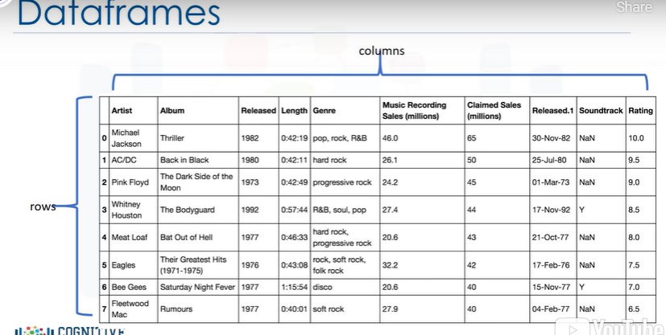
A dataframe is comprised of rows and columns.

Slide 11
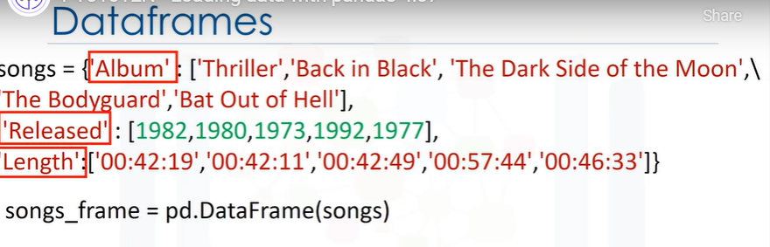
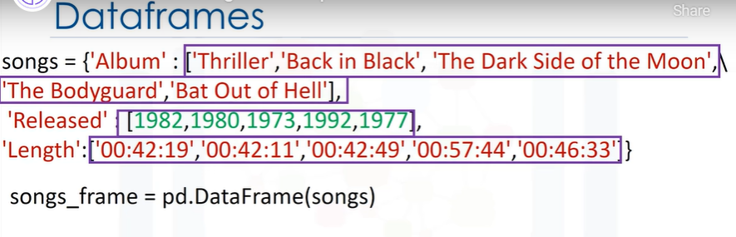
We can create a data frame out of a dictionary.
The keys correspond to the column labels.
The values are lists corresponding to the rows

Slide 12
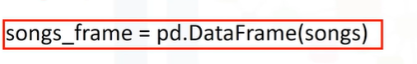
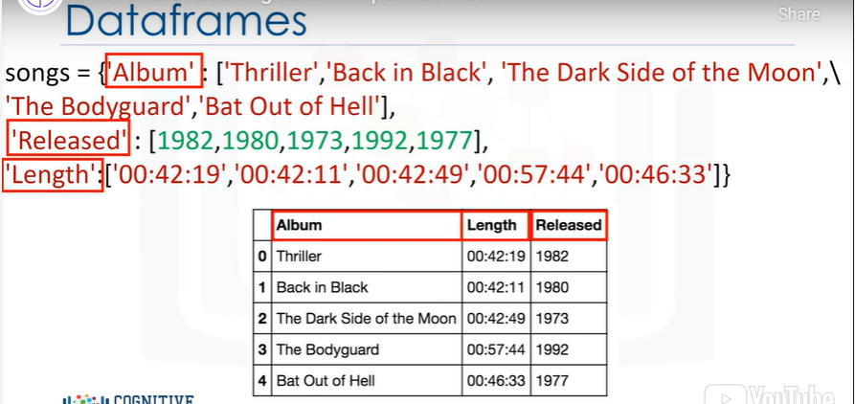
We then cast the dictionary to a dataframe using the function DataFrame.
We can see the direct correspondence between the table.
The keys correspond to the table headers.

Slide 13
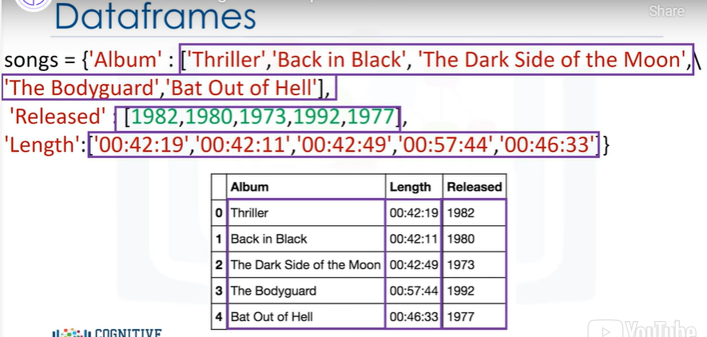
The values are lists corresponding to the rows.

Slide 14
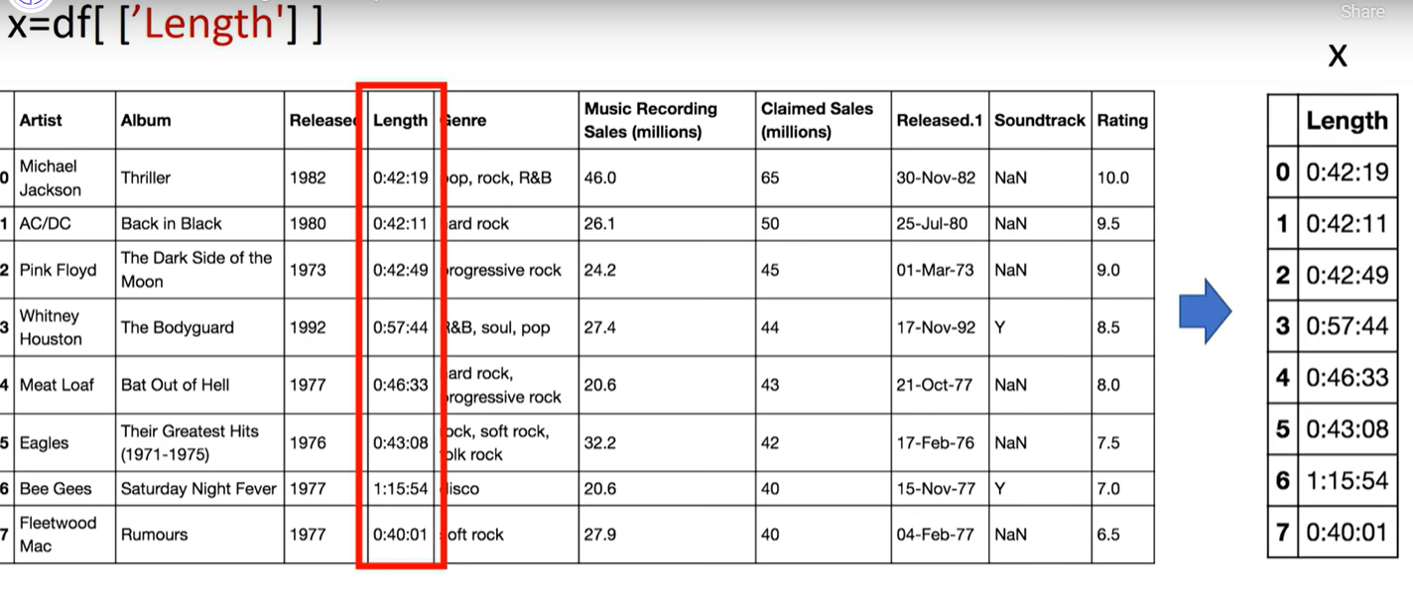
We can create a new dataframe consisting of one column.
We just put the dataframe name, in this case "df" and the name of the column header enclosed double brackets.
The result is a new dataframe comprised of the original column.

Slide 15
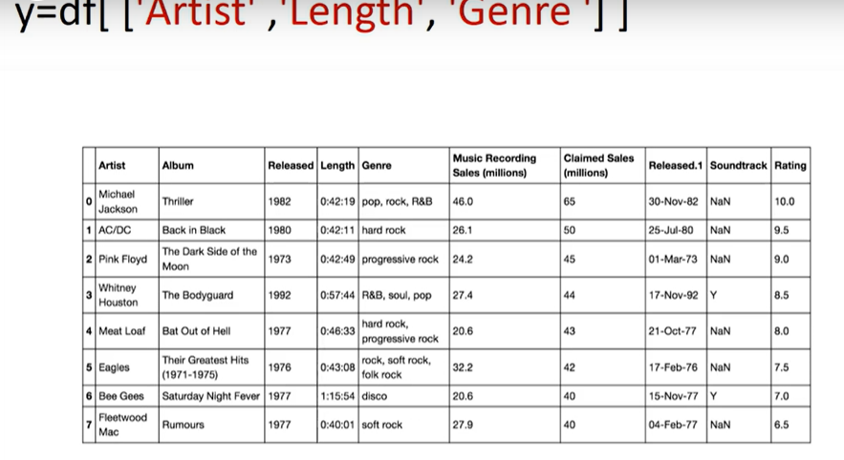
You can do the same thing for multiple columns.
We just put the dataframe name, in this case "df" and the name of the multiple column headers enclosed in double brackets.
The result is a new dataframe comprised of the specified columns.

Slide 16

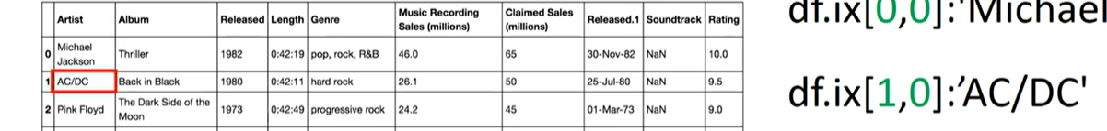
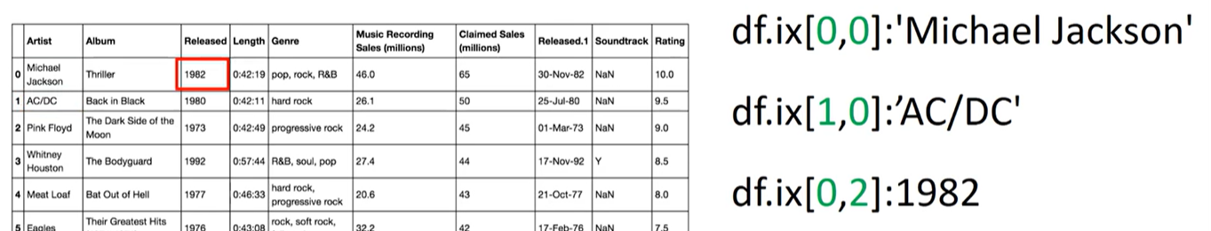
One way to access unique elements is the iloc method.
You can access the 1st row and first column as follows.
You can access the 2nd row and first column as follows.
You can access the 1st row, 3rd column as follows.
You can access the 2nd row, 3rd olumn as follows. When you use the name of the column as well,

Slide 17
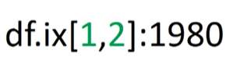
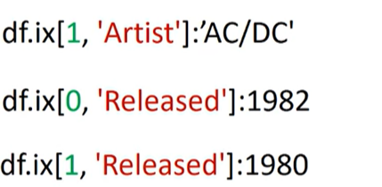
You can access the 2nd row, 3rd column as follows.
When you use the name of the column as well, you can access the 1st row of the column named 'Artist’ as follows.
Similarly, you can access the 2nd row of the column named ‘Artist.’
You can access the 1st row of the column named 'Released’ as follows.
Finally, you can access the 2nd row of the column named 'Released.’

Slide 18
You can also slice dataframes and assign the values to a new dataframe.
We assign the first two rows and the first three columns to the variable z.
The result is a dataframe comprised of the selected rows and columns.

Slide 19
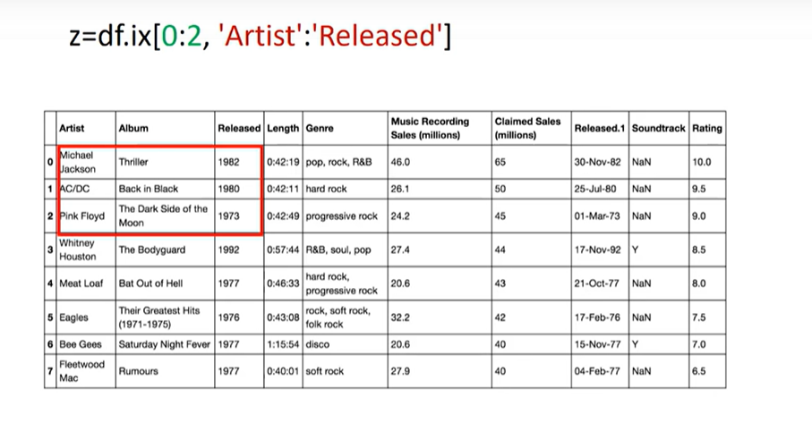
The code assigns the first three rows and all columns in-between to the columns named 'Artist’ and 'Released.’
The result is a new dataframe z with the corresponding values.

Slide 20
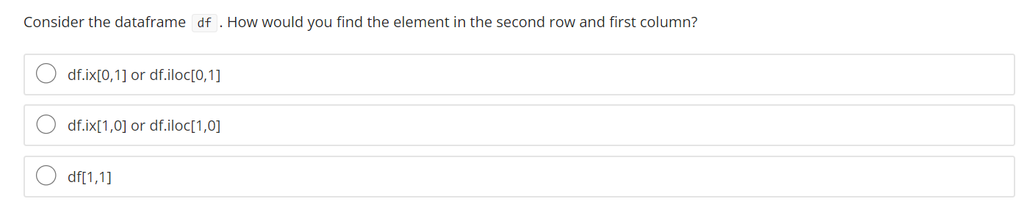
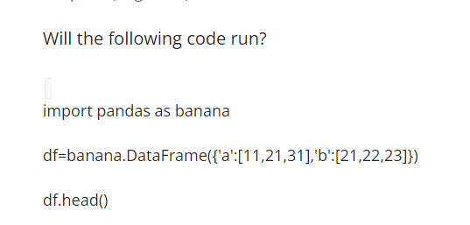

Slide 21
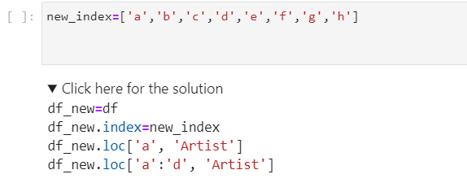

Slide 22
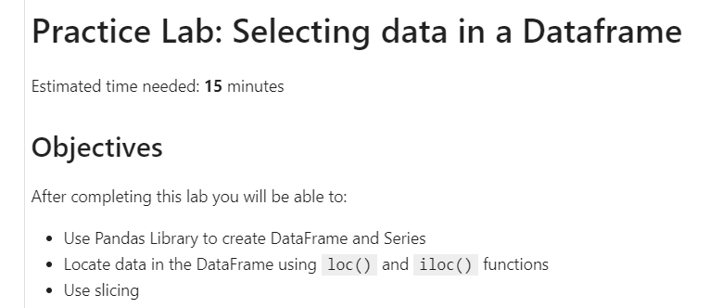

Slide 23
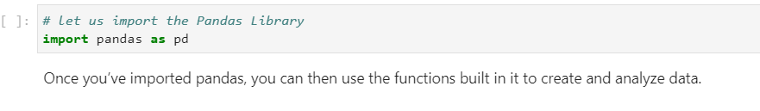
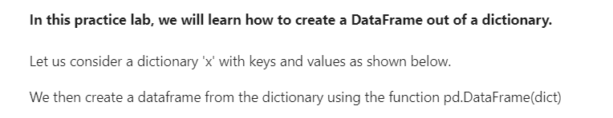
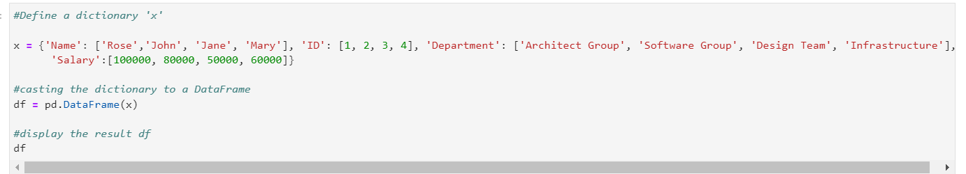

Slide 24
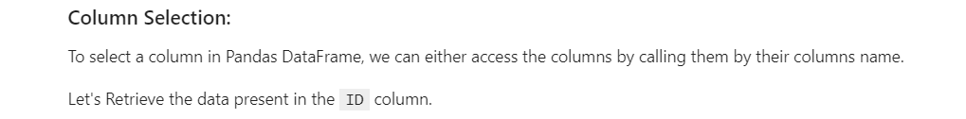
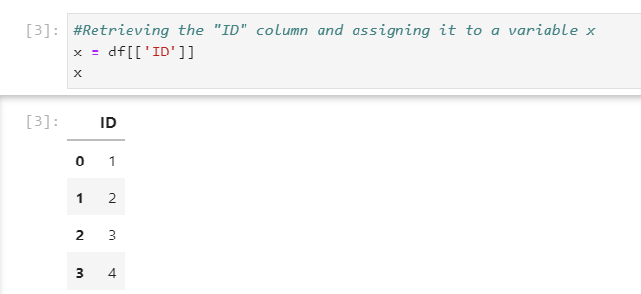

Slide 25
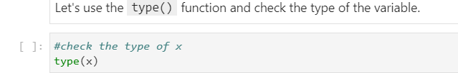
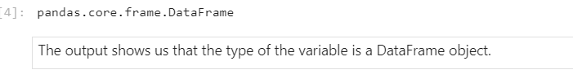
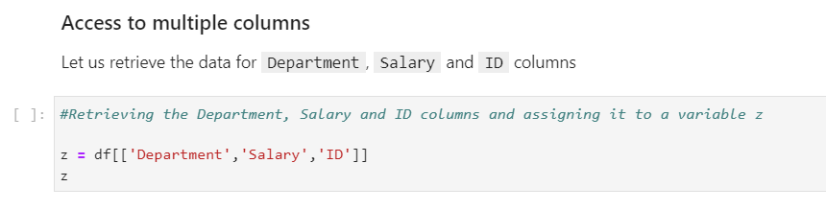

Slide 26
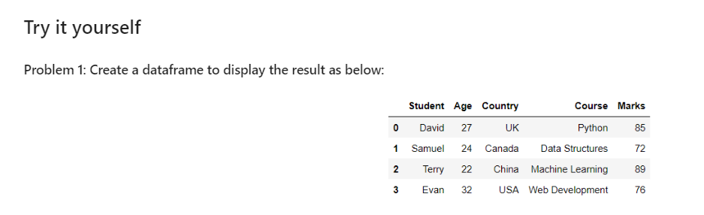
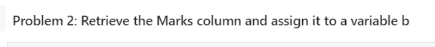
Get the Name column as a series Object

Slide 27
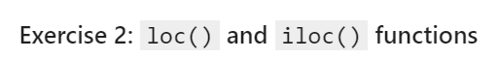
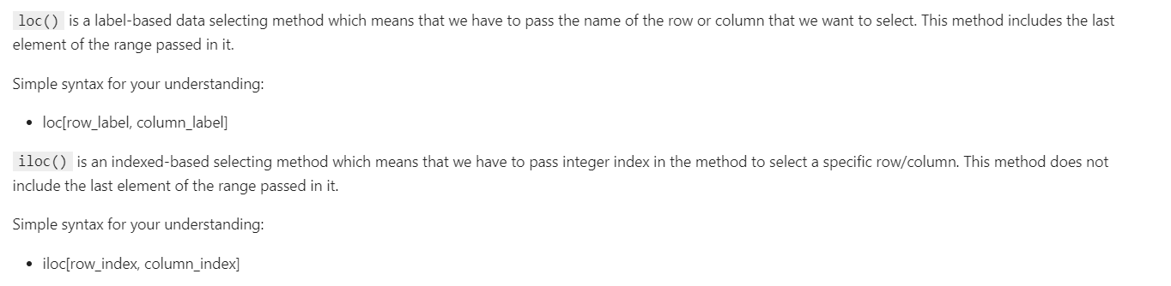
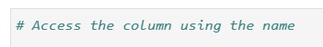

Slide 28
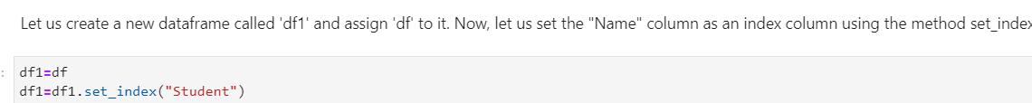
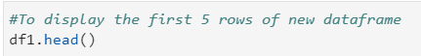
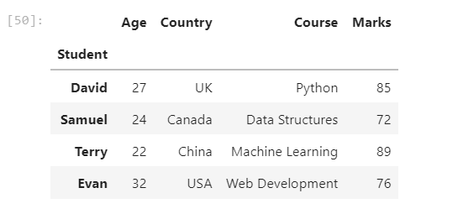
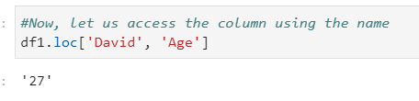

Slide 29
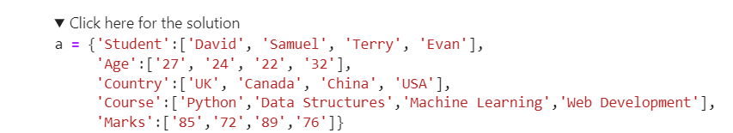
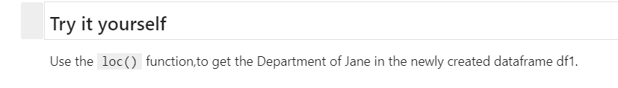
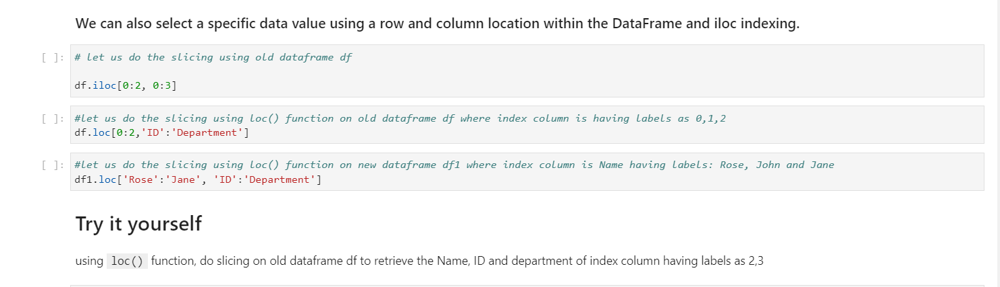

Slide 30
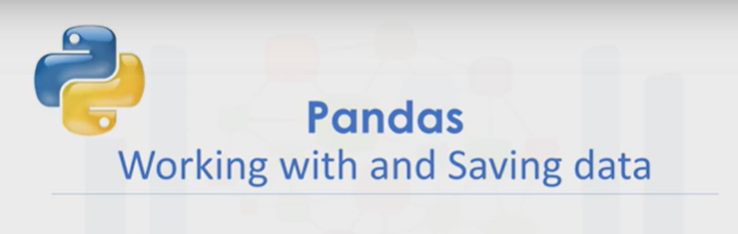
Working with and Saving Data with Pandas
When we have a dataframe we can work with the data and save the results in other formats.
Consider the stack of 13 blocks of different colors.
We can see there are three unique colors.
Let’s say you would like to find out how many unique elements are in a column of a dataframe.

Slide 31
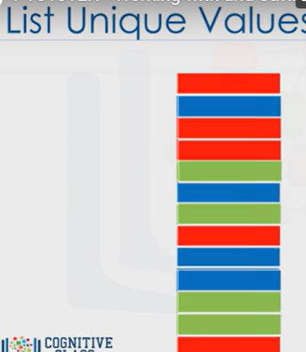

Slide 32
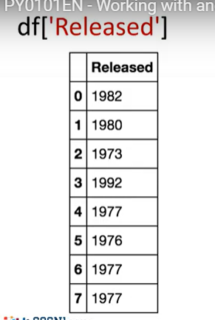
This may be much more difficult because instead of 13 elements you may have millions.
pandas has the method unique to determine the unique elements in a column of a dataframe.
Let’s say we would like to determine the unique year of the albums in the data set.

Slide 33
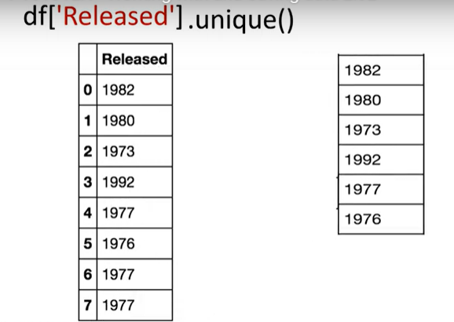
We enter the name of the dataframe, then enter the name of the column ‘Released’ within brackets.
Then we apply the method unique.
The result is all of the unique elements in the column ‘Released.’

Slide 34
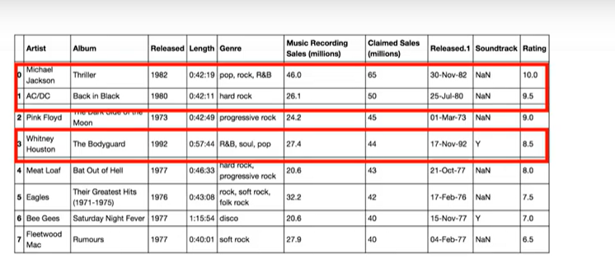
Let's say we would like to create a new database consisting of songs from the 1980's and after.
We can look at the column ‘Released’ for songs made after 1979, then select the corresponding rows.
We can accomplish this within one line of code in Pandas, but let’s break up the steps.

Slide 35

We can use the inequality operators for the entire dataframe in pandas.
The result is a series of Boolean values.
For our case, we simply specify the column ‘Released’ and the inequality for the albums after 1979.
The result is a series of Boolean values.

Slide 36

The result is true when the condition is true and false otherwise.
We can select the specified columns in one line; we simply use the dataframe’s names, and in square brackets we place the previously mentioned inequality and assign it to the variable df1.

Slide 37


We now have a new dataframe, where each album was released after 1979.
We can save the new dataframe using the method to_csv.
The argument is the name of the csv file.
Make sure you include a dot csv extension.
There are other functions to save the dataframe in other formats.

Slide 38


Slide 39




Slide 40

Numpy 2D Arrays
Consider the list "a".
The list contains three nested lists each of equal size.
Each list is color coded for simplicity.

Slide 41

Import Numpy as np
We can cast the list to a numpy array as follows.
It is helpful to visualize the Numpy array as a rectangular array; each nested list corresponds to a different row of the matrix.

Slide 42

We can use the attribute "ndim" to obtain the number of axes or dimensions referred to as the rank.
The term rank does not refer to the number of linearly independent columns like a matrix.
It's useful to think of "ndim" as the number of nested lists.
The first list represents the first dimension.
This list contains another set of lists.

Slide 43


As with the 1d array, the attribute "shape" returns a tuple.
It’s helpful to use the rectangular representation as well.

Slide 44

The second element corresponds to the size of each of the nested lists or the number of columns in the rectangular array 0.

Slide 45


The convention is to label this axis 0 and this axis 1 as follows.
We see there are three rows and three columns.

Slide 46

We can use rectangular brackets to access the different elements of the array.
The following image demonstrates the relationship between the indexing conventions for the list

Slide 47


The index in the first bracket corresponds to the different nested lists, each a different color.
The second bracket corresponds to the index of a particular element within the nested list.
Using the rectangular representation, the first index corresponds to the row index.
The second index corresponds to the column index.

Slide 48



We can also use a single bracket to access the elements as follows.
Consider the following syntax.
This index corresponds to the second row.
And this index, the third column.
The value is 23.

Slide 49

We can also use slicing in numpy arrays.
The first index corresponds to the first row.
The second index accesses the first two columns.

Slide 50


Consider this example.
The first index corresponds to the last two rows.
The second index accesses the last column.

Slide 51


We can also add arrays; the process is identical to matrix addition.
Consider the matrix X; each element is coloured differently.
Consider the matrix Y, similarly each element is coloured differently.

Slide 52

Multiplying a Numpy array by a scalar is identical to multiplying a matrix by a scalar.
Consider the matrix Y, if we multiply the matrix by the scalar 2 we simply multiply every element in the matrix by 2.

Slide 53

Hadamard product corresponds to multiplying each of the elements in the same position

Slide 54


Slide 55
We can also perform matrix multiplication with numpy arrays.
Matrix multiplication is a little more complex, but let's provide a basic overview.
Consider the matrix "A", where each row is a different colour.
Also, consider the matrix "B", where each column is a different colour.
In linear algebra, before we can multiply matrix "A" by matrix "B" we must make sure that the number of columns in matrix "A", in this case 3, is equal to the number of rows in matrix "B", in this case 3.
For matrix multiplication to obtain the i-th row and j-th column of the new matrix we take the dot product of the i-throw of "A" with the j-th columns of "B".

Slide 56



Slide 57
Pre-Processing Data in Python
If you’re unfamiliar with the term, data pre-processing is a necessary step in data analysis.
It is the process of converting or mapping data from one “raw” form into another format to make it ready for further analysis.
Data pre-processing is also often called “data cleaning” or “data wrangling”, and there are likely other terms.
Here are the topics that we’ll be covering in this module:
First, we’ll show you how to identify and handle missing values.
A “missing value” condition occurs whenever a data entry is left empty.

Slide 58
Then, we’ll cover data formats.
Data from different sources may be in various formats, in different units or in various
We will introduce some methods in Python pandas that can standardize the values into the same format, or unit, or convention.
After that, we’ll cover data normalization.
Different columns of numerical data may have very different ranges, and direct comparison is often not meaningful.
Normalization is a way to bring all data into a similar range, for more useful comparison.
Specifically, we’ll focus on the techniques of centering and scaling.

Slide 59
Binning creates bigger categories from a set of numerical values.
It is particularly useful for comparison between groups of data.
And lastly, we’ll talk about categorical variables and show you how to convert categorical values into numeric variables to make statistical modeling easier.
In Python, we usually perform operations along columns; each row of the column represents a sample, i.e., a different used car in the database.
You access a column by specifying the name of the column.

Slide 60

For example, you can access "symbolling” and “body-style”; each of these columns is a pandas series.
There are many ways to manipulate dataframes in Python.
For example, you can add a value to each entry of a column.
To add 1 to each “symbolling” entry, use this command.
This changes each value of the dataframe column by adding 1 to the current value.

Slide 61
Dealing with missing values in Python
In this video, we will introduce the pervasive problem of missing values, as well as strategies on what to do when you encounter missing values in your data.
When no data value is stored for a feature for a particular observation, we say this feature has a “missing value”.

Slide 62

Usually, missing value in dataset appears as “?”, “N/A”, 0 or just a blank cell.
In the example here, the “normalized-losses” feature has a missing value which is represented with NaN.

Slide 63
But how can you deal with missing data?
There are many ways to deal with missing values, and this is regardless of Python, R, or whatever tool you use.
However, these are the typical options you can consider:
• The first is to check if the person or group that collected the data can go back and find what the actual value should be.
Another possibility is just to remove the data where that missing value is found.

Slide 64
• When you drop data, you can either drop the whole variable or just the single data entry with the missing value.
If you don’t have a lot of observations with missing data, usually dropping the particular entry is the best.
If you’re removing data, you want to look to do something that has the least amount of impact.
Replacing data is better, since no data is wasted.
However, it is less accurate since we need to replace missing data with a guess of what the data should be.
One standard replacement technique is to replace missing values by the average value of the entire variable.

Slide 65
As an example, suppose we have some entries that have missing values for the ‘normalized-losses’ column, and the column average for entries with data is 4,500.
While there is no way for us to get an accurate guess of what the missing values under the ‘normalized-losses’ column should have been, you can approximate their values using the average value of the column, 4,500.
For a variable like ‘fuel-type’, there isn’t an “average” fuel type, since the variable values are not numbers.
In this case, one possibility is to try using the mode –the most common, like “gasoline”.
Finally, sometimes we may find another way to guess the missing data.
This is usually because the data gatherer knows something additional about the missing data.
For example, he may know that the missing values tend to be old cars, and the normalized losses of old cars are significantly higher than the average vehicle.
And of course, finally, in some cases, you may simply want to leave the missing data as missing data.
For one reason or another, it may be useful to keep that observation, even if some features are missing.

Slide 66

Now let’s go into how to drop missing values or replace missing values in Python.
To remove data that contains missing values, pandas library has a built-in method called ‘dropna’.
Essentially, with the dropna method, you can choose to drop rows or columns that contain missing values, like NaN.
So you’ll need to specify “axis=0” to drop the rows, or “axis=1” to drop the columns that contain the missing values.

Slide 67

In this example, there is a missing value in the “price” column.
Since the price of used cars is what we’re trying to predict in our upcoming analysis, we’d have to remove the cars –the rows– that don’t have a listed price.
It can simply be done in one line of code using dataframe.dropna().
Setting the argument “inplace” to “true” allows the modification to be done on the dataset directly.
“Inplace=True” just writes the result back into the dataframe.

Slide 68

This is equivalent to this line of code.
Don’t forget that this line of code does not change the dataframe, but is a good way to make sure that you are performing the correct operation.
To modify the dataframe, you have to set the parameter "inplace" equal to true.

Slide 69
To replace missing values like NaNs with actual values, pandas library has a built in method called ‘replace’, which can be used to fill in the missing values with the newly calculated values.
As an example, assume that we want to replace the missing values of the variable ‘normalized-losses’ by the mean value of the variable.
Therefore, the missing value should be replaced by the average of the entries within that Column.

Slide 70


Slide 72

In Python, first we calculate the mean of the column.
Then we use the method “replace”, to specify the value we would like to be replaced as the first parameter, in this case, NaN.
The second parameter is the value we would like to replace it with: i.e., the mean, in this example.

Slide 73
This is a fairly simplified way of replacing missing values.
There are of course other techniques, such as replacing missing values for the average of the group, instead of the entire dataset.

Slide 74
Data Formatting in Python 3:23
In this video, we’ll look at the problem of data with different formats, units, and conventions, and the pandas methods that help us deal with these issues.
Data is usually collected from different places, by different people, which may be stored in different formats.
Data formatting means bringing data into a common standard of expression that allows users to make meaningful comparisons.

Slide 75

For example, people may use different expressions to represent New York City, such as N.Y., Ny, NY, and New York.

Slide 76
Sometimes, this “uncleaned” data is a good thing to see.
For example, if you’re looking at the different ways people tend to write “New York”, then this is exactly the data that you want.
Or if you’re looking for ways to spot fraud, perhaps writing “N dot Y dot” is more likely to predict an anomaly than if someone wrote out “New York” in full.
But perhaps, more often than not, we just simply want to treat them all as the same entity, or format, to make statistical analyses easier down the road.

Slide 77

Referring to our used car dataset, there’s a feature named “city-mpg” in the dataset, which refers to a car fuel consumption in miles per gallon unit.
However, you may be someone who lives in a country that uses metric units.
So you would want to convert those values to L/100km --the metric version.
To transform mpg to L/100km we need to divide 235 by each value in the city-mpg column.
In Python, this can easily be done in one line of code.

Slide 78


You take the column and set it equal to 235 divided by the entire column.
In the second line of code, rename column name from "city-mpg" to "city-L/100km" using the dataframe.rename() method.
For a number of reasons, including when you import a dataset into Python, the data type may be incorrectly established.
For example, here we notice that the assigned data type to the price feature is “object” although the expected data type should really be an integer or float type.

Slide 79
It is important for later analysis to explore the feature’s data type and convert themto the correct data types; otherwise, the developed models later on may behave strangely,and totally valid data may end up being treated like missing data.
There are many data types in pandas.
Objects can be letters or words.
Int64 are integers.
And Floats are real numbers.

Slide 80
There are many others that we will not discuss.
To identify a features data type, in Python we can use the dataframe.dtypes method andcheck the datatype of each variable in a dataframe.
In the case of wrong datatypes, the method dataframe.astype() can be used to convert a datatype from one format to another.

Slide 81

For example, using astype(“int”) for the price column, you can convert the object column into an integer type variable.

Slide 82

Data Normalization in Python
In this video, we’ll be talking about data normalization, an important technique to understand in data pre-processing.
When we take a look at the used car data set, we notice in the data that the feature “length” ranges from 150 to 250, while feature “width” and “height” ranges from 50 to 100.

Slide 83
We may want to normalize these variables so that the range of the values is consistent.
This normalization can make some statistical analyses easier down the road.
By making the ranges consistent between variables, normalization enables a fairer comparison between the different features.
Making sure they have the same impact, it is also important for computational reasons.
Here is another example that will help you understand why normalization is important.

Slide 84

Consider a dataset containing two features: “age” and “income”, where “age” ranges from 0 to 100, while “income” ranges from 0 to 20,000 and higher.
“income” is about 1,000 times larger than “age”, and ranges from 20,000 to 500,000.
So these two features are in very different ranges.

Slide 85
When we do further analysis, like linear regression, for example, the attribute “income” will intrinsically influence the result more, due to its larger value, but this doesn’t necessarily mean it is more ‘important’ as a predictor.
So, the nature of the data biases the linear regression model to weigh income more heavily than age.

Slide 86

To avoid this, we can normalize these two variables into values that range from 0 to 1.
Compare the two tables at the right.
After normalization, both variables now have a similar influence on the models we will build later.
There are several ways to normalize data.

Slide 87

I will just outline three techniques.
The first method, called “simple feature scaling”, just divides each value by the maximum value for that feature.
This makes the new values range between 0 and 1.
The second method, called “Min-Max”, takes each value, X_old, subtracted from the minimum value of that feature, then divides by the range of that feature.
Again, the resulting new values range between 0 and 1.

Slide 88
The third method is called “z-score” or “standard score”.
In this formula, for each value, you subtract the Mu which is the average of the feature, and then divide by the standard deviation (sigma).
The resulting values hover around 0, and typically range between -3 and +3, but can be higher or lower.

Slide 89

Following our earlier example, we can apply the normalization method on the “length” feature.
First, we use the simple feature scaling method, where we divide it by the maximum value in the feature.
Using the pandas method “max”, this can be done in just one line of code.
Here’s the Min-max method on the “length” feature.

Slide 90

We subtract each value by the minimum of that column, then divide it by the range of that column: the max minus the min.

Slide 91

Finally we apply the Z-score method on length feature to normalize the values.
Here, we apply the mean() and std() method on the length feature.
mean() method will return the average value of the feature in the dataset, and std() method will return the standard deviation of the features in the dataset.

Slide 92
Binning in Python
In this video, we’ll talk about binning as a method of data pre-processing.
Binning is when you group values together into bins. For example, you can bin “age”into [0 to 5], [6 to 10], [11 to 15] and so on.
Sometimes, binning can improve accuracy of the predictive models.
In addition, sometimes we use data binning to group a set of numerical values into a smaller number of bins to have a better understanding of the data distribution.

Slide 93

As example, “price” here is an attribute range from 5,000 to 45,500.
Using binning, we categorize the price into three bins: low price, medium price, and high prices.
In the actual car dataset, ”price" is a numerical variable ranging from 5188 to 45400, it has 201 unique values.
We can categorize them into 3 bins: low, medium, and high-priced cars.

Slide 94

In Python we can easily implement the binning: We would like 3 bins of equal binwidth, so we need 4 numbers as dividers that are equal distance apart.
First we use the numpy function “linspace” to return the array “bins” that contains 4 equally spaced numbers over the specified interval of the price.

Slide 95

We create a list “group_names “ that contains the different bin names.
We use the pandas function ”cut” to segment and sort the data values into bins.
You can then use histograms to visualize the distribution of the data after they’ve been divided into bins.
This is the histogram that we plotted based on the binning that we applied in the price feature.

Slide 96
From the plot, it is clear that most cars have a low price, and only very few cars have high price.

Slide 97
Turning categorical variables into quantitative variables in Python
In this video, we’ll discuss how to turn categorical variables into quantitative variables in Python.
Most statistical models cannot take in objects or strings as input and, for model training, only take the numbers as inputs.
In the car dataset, the "fuel-type" feature as a categorical variable has two values, "gas" or "diesel”, which are in String format.

Slide 98

For further analysis, Jerry has to convert these variables into some form of numeric format.
We encode the values by adding new features corresponding to each unique element in the
original feature we would like to encode.
In the case where the feature “Fuel” has two unique values, gas and diesel, we create two new features ‘gas’ and ‘diesel.'

Slide 99

When a value occurs in the original feature we set the corresponding value to one in the new feature; the rest of the features are set to zero.
In the fuel example, for car B, the fuel value is diesel.
Therefore, we set the feature diesel equal to one and the gas feature to zero.

Slide 100

Similarly, for car D the fuel value is gas.
Therefore we set the feature gas equal to one and the feature diesel equal to zero.
This technique is often called “one-hot encoding”.
In pandas, we can use get_dummies() method to convert categorical variables to dummy variables.

Slide 101
In Python, transforming categorical variables to dummy variables is simple.
Following the example, pd.get_dummies() method gets the fuel-type column and creates the dataframe"dummy_variable_1".
The get_dummies() method automatically generates a list of numbers, each one corresponding to a particular category of the variable.

Slide 102
Exploratory Data Analysis
In this module we’re going to cover the basics of Exploratory Data Analysis using Python.
Exploratory Data Analysis, or in short “EDA”, is an approach to analyze data in order to: - summarize main characteristics of the data - gain better understanding of the dataset,- uncover relationships between different variables, and- extract important variables for the problem we are trying to solve.
The main question we are trying to answer in this module is:
“What are the characteristics that have the most impact on the car price?”

Slide 103


Slide 104
We will be going through a couple of different useful exploratory data analysis techniques in order to answer this question.
In this module you will learn about: Descriptive Statistics, which describe basic features of a dataset and obtains a short summary about the sample and measures of the data.
Basic of Grouping Data using groupby, and how this can help to transform our dataset.
ANOVA, the analysis of variance, a statistical method in which the variation in a set of observations is divided into distinct components.
The Correlation between different variables.
And lastly, Advanced Correlation, where we’ll introduce you to various correlation statistical methods, namely Pearson Correlation and Correlation Heatmaps.

Slide 105
Descriptive Statistics
In this video, we’ll be talking about Descriptive Statistics.
When you begin to analyze data, it’s important to first explore your data before you spend time building complicated models.
One easy way to do so is to calculate some
descriptive statistics for your data.
Descriptive statistical analysis helps to describe basic features of a dataset and obtains a short summary about the sample and measures of the data.

Slide 106

Let’s show you a couple different useful methods.
One way in which we can do this is by using the describe() function in pandas.
Using the describe function and applying it on your dataframe, the "describe" function automatically computes basic statistics for all numerical variables.

Slide 107
It shows the mean, the total number of data points, the standard deviation, the quartiles and the extreme values.
Any NaN values are automatically skipped in these statistics. This function will give you a clearer idea of the distribution of your different variables.
You could have also categorical variables in your dataset.
These are variables that can be divided up into different categories, or groups and have discrete values.

Slide 108

For example, in our dataset we have the drive system as a categorical variable, which consists of the categories: forward-wheel drive, rear-wheel drive, and four-wheel drive. One way you can summarize the categorical data is by using the function value_counts().
We can change the name of the column to make it easier to read.
We see that we have 118 cars in the fwd (front wheel drive) category,

Slide 109

75 cars in the rwd (rear wheel drive) category, and 8 cars in the 4wd (four wheel drive) category.
Boxplots are a great way to visualize numeric data, since you can visualize the various distributions of the data.
The main features that the boxplot shows are the median of the data, which represents where the middle datapoint is.

Slide 110


Slide 111
The Upper Quartile shows where the 75th percentile is, the Lower Quartile shows where the 25th percentile is.
The data between the Upper and Lower Quartile represents the Interquartile Range.
Next, you have the Lower and Upper Extremes.
These are calculated as 1.5 times the interquartile range above the 75th percentile, and as 1.5 times the IQR below the 25th percentile.

Slide 112

https://online.stat.psu.edu/stat200/lesson/3/3.2#:~:text=To%20build%20this%20fence%20we,above%20Q3%20are%20considered%20outliers.

Slide 113


Slide 114
Finally, boxplots also display outliers as individual dots that occur outside the upper and lower extremes.
With boxplots, you can easily spot outliers and also see the distribution and skewness of the data.

Slide 115

Boxplots make it easy to compare between groups.
In this example, using Boxplot we can see the distribution of different categories of the “drive-wheels” feature over price
feature.
We can see that the distribution of price between the rwd (rear wheel drive) and the other categories are distinct, but the price for fwd (front wheel drive) and 4wd (four wheel drive) are almost indistinguishable.

Slide 116
Often times we tend to see continuous variables in our data. These data points are numbers contained in some range.
For example, in our dataset, price and engine size are continuous variables.
What if we want to understand the relationship between “engine size” and ”price”?
Could engine size possibly predict the price of a car?
One good way to visualize this is using a scatter plot.
Each observation in a scatter plot is represented as a point.

Slide 117
This plot shows the relationship between two variables:
The predictor variable: is the variable that you are using to predict an outcome.
In this case, our predictor variable is the engine size.
The target variable: is the variable that you are trying to predict. In this case, our target variable is the price, since this would be the outcome.

Slide 118
In a scatterplot, we typically set the predictor variable on the x-axis, or horizontal axis and we set the target variable on the y-axis or vertical axis.
In this case, we will thus plot the engine size on the x-axis and the price on the y-axis.
We are using the Matplotlib function “scatter” here, taking in x and a y variable.
Something to note is that it’s always important to label your axes and write a general plot title, so that you know what you are looking at.

Slide 119


Slide 120
Now how is the variable Engine Size related to Price?
From the scatterplot we see that as the engine size goes up, the price of the car also goes up.
This is giving us an initial indication that there is a positive linear relationship between these two variables.

Slide 121
GroupBy in Python

